Slide 1
Time Series
Time is not a line, but a series of new points

Slide 2
Time Series Analysis
Introduction
Filter
ETS Models

Slide 3
Introduction

Slide 4
Time Series Analysis
“Time series analysis is a statistical technique that deals with time series data, or trend analysis.”
Time series data means that data is in a series of particular time periods or intervals.
Time series data has particular properties, lets take a look at some important terms.

Slide 5
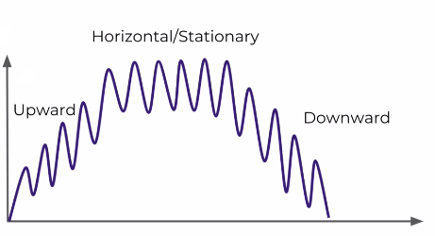
Time Series Analysis
Trends

Slide 6
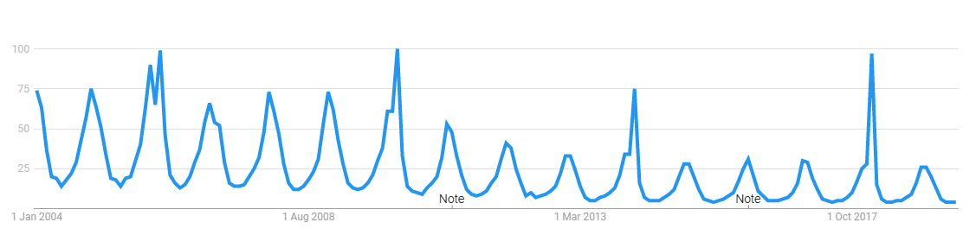
Time Series Analysis
Seasonality – Repeating trends
Google Trends – “Snowboarding”

Slide 7
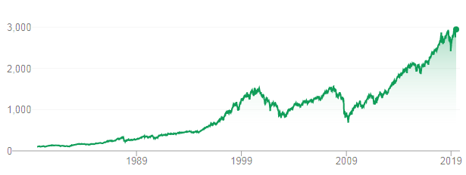
Time Series Analysis
Cyclical – Trends with no set repetition
SP500

Slide 8
Filter
Separating the Time Series Components

Slide 9

Time Series Analysis
Filter
Hodrick – Prescott Filter
The Hodrick-Prescott filter separates:
A time-series y_{t} (All our time series data)
Into
A trend component Ƭ_{t}
A cyclical component c_{t}
So Basically, it tries to find the trend component and the cyclical component of the data.

Slide 10

Time Series Analysis
Filter
Hodrick – Prescott Filter
The components
A trend component Ƭ_{t}
A cyclical component c_{t}
Are determined by minimizing the following quadratic loss function:
Where,
λ = Smoothing parameter, handles variation in growth rate of trend component.

Slide 11
Time Series Analysis
Filter
Hodrick – Prescott Filter
Default values for λ:
When analyzing quarterly data, use λ = 1600
When analyzing annual data, use λ = 6.25
When analyzing monthly data, use λ = 129,600

Slide 12
ETS Models
Error – Trend - Seasonality

Slide 13
Time Series Analysis
ETS Models – Time Series Decomposition
ETS Models stands for Error – Trend – Seasonality
This general term, actually stands for wide variety of ETS models.
ETS Decomposition
Exponential Smoothing
Trend Methods Models
ETS Models takes each of these terms (E-T-S) for ‘smoothing’ and may add them, multiply them or even just leave some of them out.
Based off these key factors, we can try to create a model to fit our data.

Slide 14
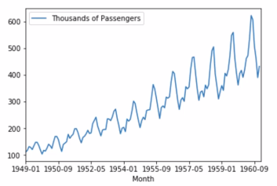
Time Series Analysis
ETS Models – ETS Decomposition
Airline Passengers

Slide 15
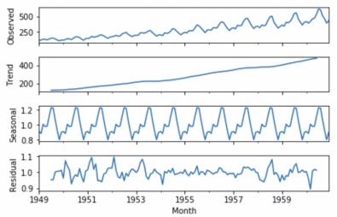
Time Series Analysis
ETS Models – ETS Decomposition

Slide 16
Time Series Analysis
ETS Models – ETS Decomposition
Things to remember while doing ETS decomposition
There are two types of ETS models:
Additive Model
Multiplicative Model
Additive Mode: We apply additive model when it seems that the trend is more linear and the seasonality and trend components seem to be constant over time.
(e.g. every year we add 1000 passengers)
Multiplicative Model: This is more appropriate when we are increasing at a non-linear rate
(e.g. each year we double the amount of passengers)

Slide 17
EWMA
Exponentially Weighted Moving Average

Slide 18
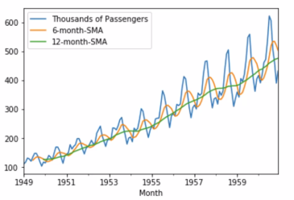
Time Series Analysis
EWMA Models
Before that, we saw SMA (Simple Moving Averages)

Slide 19
Time Series Analysis
EWMA Models – Problems with SMA
The problem with SMA is that the entire model is constrained to the same window size (rolling window).
Also, smaller window will lead to more noise, rather than signal.
SMA will never reach the full peak or valley of the data due to the averaging.
Extreme historical values can skew your SMA significantly.
To help fix these issues, we use EWMA.

Slide 20
Time Series Analysis
EWMA Models
EWMA allows to reduce the lag effect from SMA and it will put more weight on values that occurred more recently
(By applying more weight to the more recent values, thus the name Exponential)
The amount of weight applied to the most recent values will depend on:
The actual parameters used in EWMA
The number of periods given a window size

Slide 21
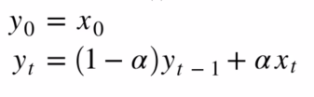
Time Series Analysis
EWMA Models
EWMA uses Single Exponential Smoothing
Where,
y₀ = x₀ means, First input value = First output value
y_{t} = output value for the rest of the inputs, calculated by formula

Slide 22
Holt – Winters Method

Slide 23
Time Series Analysis
Holt – Winters Method
Before that…
We saw Exponential Weighted MA where we applied Simple Exponential Smoothing using just one factor ‘alpha’.
This is fine, but it fails to account for other contributing factors like overall trend and seasonality.
This can be fixed using Holt-Winters method.
Note that, Holt-Winters method can be used for forecasting.
But for now, lets see the concept of it.

Slide 24
Time Series Analysis
Holt – Winters Method
Holt(1957) came up with Double Smoothing method
Winters (1960) extended this method to capture seasonality.
Thus the Holt-Winters method comprise of forecast equation and three additional smoothing equations.
These three smoothing equations are for :
Level Component = l_{t} (smoothing parameter is alpha)
Trend Component = β_{t} (smoothing parameter is beta)
Seasonal Component = γ_{t} (smoothing parameter is gamma)

Slide 25
Time Series Analysis
Holt – Winters Method
There are two variations to this method depending on the nature of seasonal component
Additive Method: This is preferred when the seasonal variations are roughly constant through the series.
Multiplicative Method: This is preferred when the seasonal variations are changing proportional to the levels of the series.

Slide 26
Time Series Analysis
Holt – Winters Method
Recap:
EWMA uses Single Exponential Smoothing
Where,
y₀ = x₀ means, First input value = First output value
y_{t} = output value for the rest of the inputs, calculated by formula

Slide 27




Time Series Analysis
Holt – Winters Method
Holt’s Method:
We can expand on Single Exponential Smoothing in Holt’s method.
This is also know as Double Exponential Smoothing.
Here we introduce a new smoothing factor β (beta) that addresses trend:
Level
Trend
Fitted Model
Forecasting Model (h = # periods into the future)

Slide 28
Time Series Analysis
Holt – Winters Method
Holt’s Method (Double Exponential Smoothing)
The reason it is called Double Exponential Smoothing is that we are not dealing with two smoothing parameters alpha and beta.
As we have not considered the seasonal parameter, the forecasting model is essentially just a simple straight extending from the most recent data point.
Level
Trend
Fitted Model
Forecasting Model (h = # periods into the future)

Slide 29
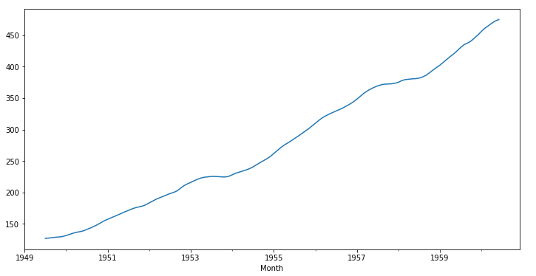
Time Series Analysis
Holt – Winters Method
Holt’s Method (Double Exponential Smoothing)
As we have not considered the seasonal parameter, the forecasting model is essentially just a simple straight extending from the most recent data point.
What does this mean ?
If we take a look at this model, we are just considering the value at level and the corresponding trend, whether its sloping upwards or downwards. We are not taking into account the seasonality.
So, if we use this method to the airlines data, we will be able to predict that number of passengers are increasing.
But we will not be able to predict that it increases more rapidly during the summers than the winters.

Slide 30


Time Series Analysis
Holt – Winters Method
Lets introduce another smoothing factor (gamma) to address the seasonality.
This method is Holt’s – Winter Method also known as Tripe Smoothing Method.
Level
Trend
Seasonal
Fitted Model
Forecasting Model (m = # periods into the future)
Here, L = No of divisions per cycle.
E.g. If we are looking at passengers monthly data, that repeats the pattern each year, we would sat L=12.

